Slide 1
Tutorial 8&9 – Hypothesis Testing
PSYC 2020J
November 24, 2022

Slide 2
Announcements
Assignment 2
Due December 1th 2:30 pm
Test 2
Dec 6th at 2:30 pm
Review class with Dr. Check (Tues, Nov 29)
Review session during the tutorial (Thurs, Dec 1 )
Non-cumulative, material from Test 1 to Nov. 29th

Slide 3
Review from Tutorial 7

Slide 4
Important Concepts
Parameter estimation
Using sample to make inferences about the population
Point vs Interval Estimates
Confidence intervals
The range where we expect our parameter to lie (based on our estimation through calculation) based on our sample and a set confidence level (𝛼)
CIs rely on standard error

Slide 5
Standard Error Example
Calculate the standard error of the given sample data:
y: 5, 10, 12, 15, 20
Step 1: Find the mean
Step 2: Find the sd
Step 3: Find the se

Slide 6
Confidence Intervals (CI)
𝐶𝐼 = 𝑥̅ ± 𝑧_{𝛼}(𝜎_{𝑥̅})
𝑥̅ - mean
𝑧_{𝛼} - Z value at alpha level, 𝛼
“Z critical”
𝜎_{𝑥̅} Standard Error of the mean (SE)
•
𝜎
n
𝑛

Slide 7
Constructing CIs
Know 𝜎_{𝑥̅} Don’t know 𝜎_{𝑥̅}
Use z table for critical value • Use t table for critical value
Can calculate 𝜎_{𝑥̅} • Need to use 𝒔_{𝒙} to approximate
^{𝜎}𝑥̅
-
𝑥̅ ± 𝑧_{𝛼}(𝜎_{𝑥̅})
𝑥̅ ± 𝒕_{𝑎}(𝒔_{𝒙})
t approaches normality at large df (df = n - 1)
Thus, at large n, t=z=1.96

Slide 8
New material

Slide 9
Important Concepts
Descriptive vs Inferential Stats
Level of confidence, 𝛼
“Proving” in Psychology
We don’t prove ANYTHING in psychology
The only exception are existence proofs
We do everything in terms of probability
Some level of certainty (confidence)

Slide 10
“Proving” in Psychology
We don’t prove ANYTHING in psychology
The only exception are existence proofs
We do everything in terms of probability
Some level of certainty (confidence)

Slide 11
Hypothesis testing (NHST)
NHST – Null Hypothesis Significance Testing
We are asking: “How likely is this difference we found in our sample attributable to error?”
H₀: no difference, any difference we observed could be error and not a true
difference
H₁: difference observed is likely due to a true difference between the sample

Slide 12
Hypothesis testing (NHST)
The null hypothesis (H₀)
there is “no effect/change/difference” side
The alternative hypothesis, (H₁)
There is an “effect/change difference” side
Sometimes called the “experimental hypothesis”
^{𝐻}1^{: 𝜇}𝑝𝑜𝑝 ^{≠ 𝜇}𝑠𝑎𝑚𝑝𝑙𝑒
^{𝐻}0^{: 𝜇}𝑝𝑜𝑝 ^{= 𝜇}𝑠𝑎𝑚𝑝𝑙𝑒

Slide 13
Hypothesis testing (NHST)
Mutual exclusivity: the null and alternative hypotheses are mutually exclusive
There is no overlap between them, and only one can be more likely if hypothetically speaking, the null is true (both cannot be ”accepted”)
Mutually exhaustive: they should both cover all possible situations

Slide 14
The Logic of NHST
Is there a bigger difference between our sample and the population than we would expect to find on chance alone?
How do we quantify this? We use test statistics
z when population parameters are known
t when population parameters are unknown
𝑂𝑏𝑠𝑒𝑟𝑣𝑒𝑑 𝑑𝑖𝑓𝑓𝑒𝑟𝑒𝑛𝑐𝑒 (𝑒𝑓𝑓𝑒𝑐𝑡)
𝑒𝑥𝑝𝑒𝑐𝑡𝑒𝑑 𝑑𝑖𝑓𝑓𝑒𝑟𝑒𝑛𝑐𝑒 (𝑒𝑟𝑟𝑜𝑟)
Is the effect we observed strong enough relative to error?

Slide 15
The Logic of NHST
𝑂𝑏𝑠𝑒𝑟𝑣𝑒𝑑 𝑑𝑖𝑓𝑓𝑒𝑟𝑒𝑛𝑐𝑒 (𝑒𝑓𝑓𝑒𝑐𝑡)
𝑒𝑥𝑝𝑒𝑐𝑡𝑒𝑑 𝑑𝑖𝑓𝑓𝑒𝑟𝑒𝑛𝑐𝑒 (𝑒𝑟𝑟𝑜𝑟)
If there is a bigger effect than expected from chance, we say there is a real difference
“statistically significant”
How do we quantify this difference?
A test statistic!

Slide 16
The Logic of NHST
Another way of thinking about it: is our value “extreme” enough?
We use the probability distributions here (z or t)
For z, +/- 1.96 is our value at 𝛼 = .05 (95%)
All hypothesis testing can be thought of as:
_{𝑡𝑒𝑠𝑡 𝑠𝑡𝑎𝑡𝑖𝑠𝑡𝑖𝑐 =} 𝑠𝑎𝑚𝑝𝑙𝑒 𝑠𝑡𝑎𝑡𝑖𝑠𝑡𝑖𝑐 − 𝑝𝑜𝑝𝑢𝑙𝑎𝑡𝑖𝑜𝑛 𝑝𝑎𝑟𝑎𝑚𝑒𝑡𝑒𝑟
𝑠𝑡𝑎𝑑𝑎𝑟𝑑 𝑒𝑟𝑟𝑜𝑟 𝑜𝑓 𝑡ℎ𝑒 𝑠𝑎𝑚𝑝𝑙𝑒 𝑠𝑡𝑎𝑡𝑖𝑠𝑡𝑖𝑐
“Standardized difference between the sample and population”

Slide 17
Directional vs Non-directional tests
Non-directional (most common)
Our confidence level, 𝛼, is split between the two extreme tails in our probability distribution

Slide 18
Evaluating Hypotheses
Define hypotheses
Null (H₀) & Experimental/Alternate (H₁)
Set criteria and 𝛼
Collect Data & calculate test statistic
Make decision
Reject or fail to reject H0 using critical values
Region of rejection (outer tails) vs region of retention (inner region)
Probability

Slide 19
Conceptualizing NHST
Critical Value
Using standardized scores
Compare test statistic to critical value
Retention and Rejection regions
Look at the probability distribution
Confidence intervals (!)
Look for 𝜇

Slide 20
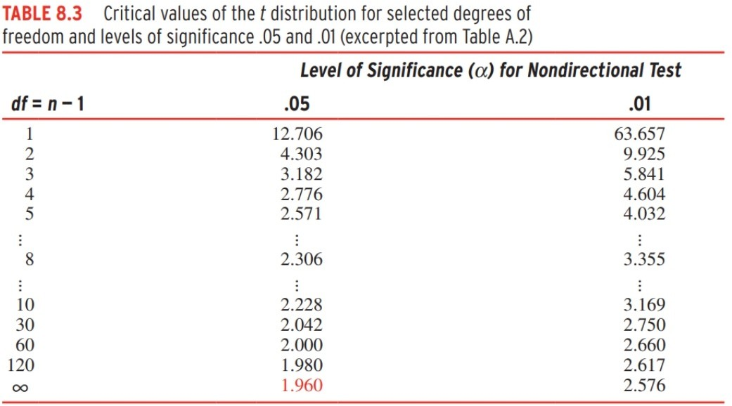
Changing the 𝛼
We change: the critical value, rejection/retention region border, confidence interval

Slide 21
What do we do with non-sig results?
No, we can’t change our hypotheses, this is “p-hacking” (VERY bad)
Besides that, it is dishonest, and this is a MASSIVE problem in psychology
“the replication crisis”
We can do more exploratory analyses, but you have to report it
Registered reports!

Slide 22
Evaluating Hypotheses
Define hypotheses
Null (H₀) & Experimental/Alternate (H₁)
Set criteria and 𝛼
Compute the test statistic
Make decision
Reject or fail to reject H0 using critical values
Region of rejection (outer tails) vs region of retention (inner region)
Probability

Slide 23
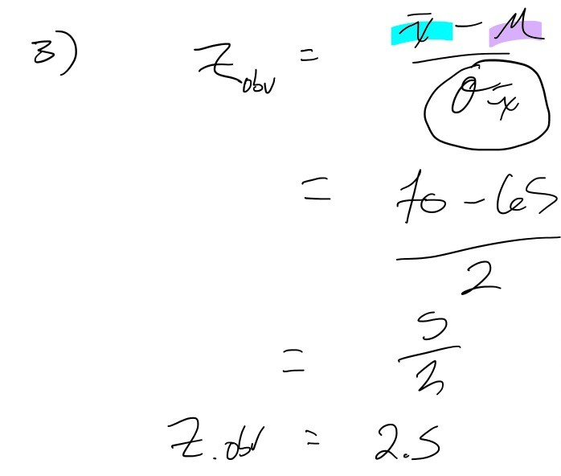
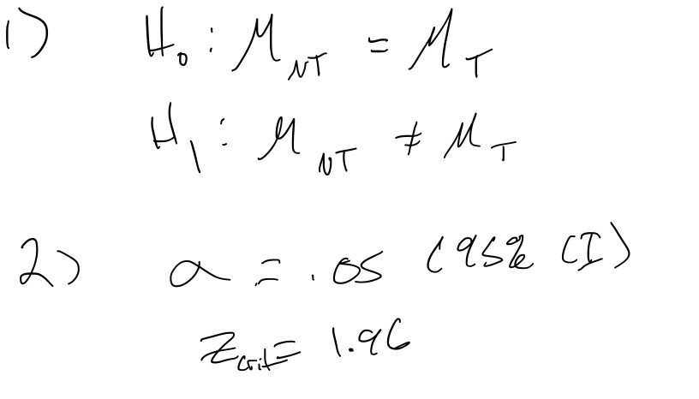
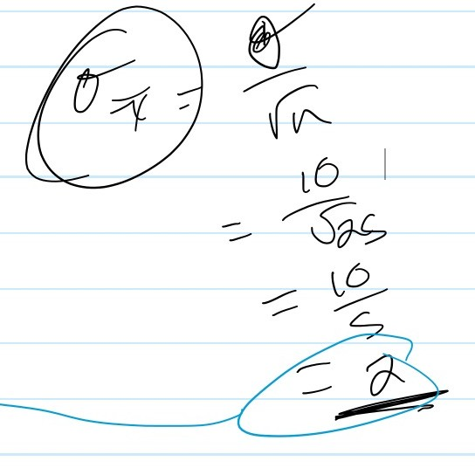
Evaluating Hypotheses Example
Does attending tutorial affect final grades?
Typical final grades (NT – no tutorial): 𝜇_{𝑁𝑇} = 65, 𝜎_{𝑁𝑇} = 10
Tutorial final grades (T – tutorial): 𝑋¹_{𝑁𝑇} = 70, 𝑛 = 25

Slide 24
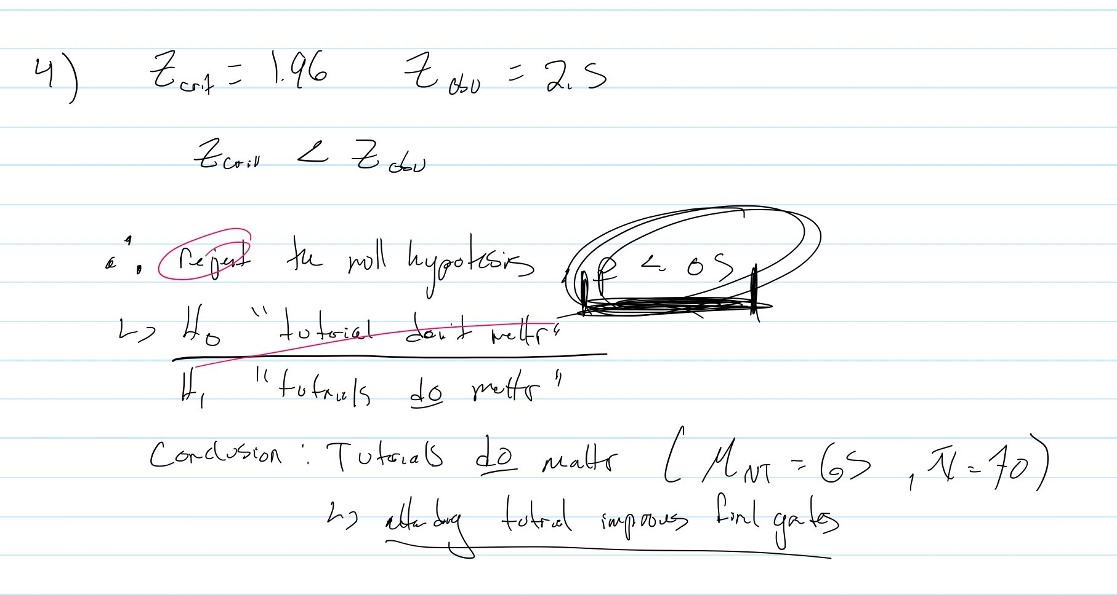
Evaluating Hypotheses Example
Does attending tutorial affect final grades?
Typical final grades (NT – no tutorial): 𝜇_{𝑁𝑇} = 65, 𝜎_{𝑁𝑇} = 10
Tutorial final grades (T – tutorial): 𝑋¹_{𝑁𝑇} = 70, 𝑛 = 25

Slide 25
Conceptualizing NHST
Critical Value
Using standardized scores
Compare test statistic to critical value
Retention and Rejection regions
Look at the probability distribution
Confidence intervals (!)
Look for 𝜇

Slide 26
Effect Sizes
A way to avoid detriments of p-hacking
Becoming a reporting standard
How much different?
Practical vs statistical significance
E.g., difference between means, test statistics, standardized effect size statistics (Cohen's d, partial eta squared)

Slide 27
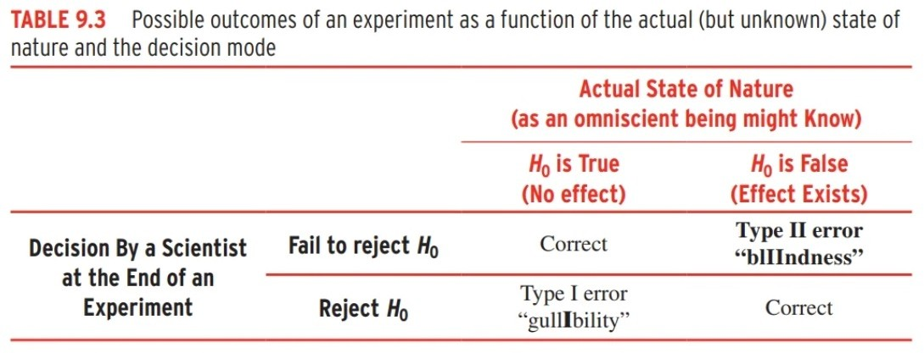
Type I & Type II Errors
(Hurlbut, 2017, pg. 212)

Slide 28
Type I & Type II Errors
Type I Error
“false positive”
𝛼 : “How willing are we to say there is an effect when there is not?”
.05 (in 100 samples, we will say there is an effect when there is not 5 times)
Type II Error
“false negative”
𝛽 : “How willing are we to say there is no effect when there is?”
.20 (in 100 samples, we will say there is no effect when there is 20 times)

Slide 29
Power
The power of a test is the ability to detect a true effect
The probability of missing a true effect
1 - 𝛽
What if you fail to reject the null?
Is the effect not there? Or were you just not able to find it?
Your study may be under-powered
H₀ is false, but you couldn’t reject H₀

Slide 30
What Affects Power?
n
n, ↓ 𝛽 – Power increases
𝜎
𝜎, 𝛽 – Power decreases
Effect Size
𝐸𝑆, ↓ 𝛽 – Power increases
𝛼 is unchanged

Slide 31
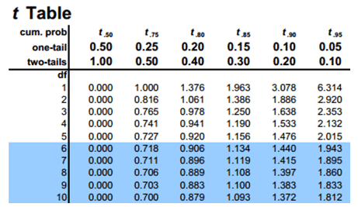
What Affects Power
One tailed vs two tailed
One tailed tests have more power than two tailed tests
Easier to reach threshold for significance in a one-tailed test
𝛼
𝗍 𝛼, ↓ 𝛽 – Power increases
↓ 𝛼, 𝗍 𝛽 – Power decreases

Slide 32
Practice Questions

Slide 33
Evaluating Hypotheses
Define hypotheses
Null (H₀) & Experimental/Alternate (H₁)
Set criteria and 𝛼
Collect Data & calculate test statistic
Make decision
Reject or fail to reject H0 using critical values
Region of rejection (outer tails) vs region of retention (inner region)
Probability

Slide 34
Question 1
In previous years, a class had final exam grades with μ = 60 and σ = 10. The professor believed that student’s test-taking abilities could suffer if they did not stay hydrated during long tests, so they instructed their students to take water bottles to the test. Afterwards, they took a sample of 49 students and found the sample had a mean of 62.5. At α =
.05, is this difference significant?

Slide 36
Question 2
A local restaurant wondered if changing its menu organization would impact the amount of money customers spent. In the past, the average spending was $34. After trying the new menu on 36 customers, they found spending averaged $30 and had a standard deviation of $12. Use α = .05.

Slide 38
Question 3
A bald man is convinced that bald men are generally more intelligent than the general population. Being a man fixated with his own perceived intelligence he believes IQ is a meaningful measure and sets out to prove his idea by collecting a sample of 900 bald men and finds their average IQ to be 102. Recall that IQ has a μ = 100 & σ = 15. Test at α = .01, 2-tailed.

